Slide 1
Understanding Dynamic Websites

Slide 2
Understanding the Different Types of Scripting
Server-side scripting refers to scripts that run on the web server, which then sends results to your web browser.
If you have ever submitted a form at a website, which includes using a search engine, you have experienced the results of a server-side script.
Popular server-side scripting languages include the following (to learn more, visit the websites listed here):
  . PHP (PHP: Hypertext Preprocessor)—http://www.php.net/
  . JSP (Java Server Pages)—http://java.sun.com/products/jsp/
  . ASP (Active Server Pages)—http://www.asp.net/
  . Perl—http://www.perl.org/
  . Python—http://www.python.org/
  . Ruby—http://www.ruby-lang.org/

Slide 3
Understanding the Different Types of Scripting
On the other hand, client-side scripting refers to scripts that run within your web browser; there is no interaction with a web server in order for the scripts to run.
The most popular client-side scripting language, by far, is JavaScript.
For several years, research has shown that more than 93% of all web browsers have JavaScript enabled.

Slide 4
Including JavaScript in HTML
JavaScript code can live in one of two places within your files:
In its own file with a .js extension .
Directly in your HTML files External files are often used for script libraries (code you can reuse throughout many pages), whereas code appearing directly in the HTML files tends to achieve functionality specific to those individual pages.
Regardless of where your JavaScript lives, your browser learns of its existence through the use of the <script></script> tag pair.
When you store your JavaScript in external files, it is referenced in this manner:
  <script type=”text/javascript” src=”/path/to/script.js”>
These <script></script> tags are typically placed between the <head></head> tag because it is not, strictly speaking, content that belongs in the <body> of the page.
Instead, the <script> makes available a set of JavaScript functions or other information that the rest of the page can then use.
However, you can also just encapsulate your JavaScript functions or code snippets with the <script> and place them anywhere in the page, as needed.

Slide 5
Using JavaScript to Print Some Text
<?xml version=”1.0” encoding=”UTF-8”?>
<!DOCTYPE html >
<html>
<head>
<title>JavaScript Example</title>
</head>
<body>
<h1>JavaScript Example</h1>
<p>This text is HTML.</p>
<script type=”text/javascript”>
<!-- Hide the script from old browsers
document.write(‘<p>This text comes from JavaScript.</p>’);
// Stop hiding the script -->
</script>
</body>
</html>

Slide 6
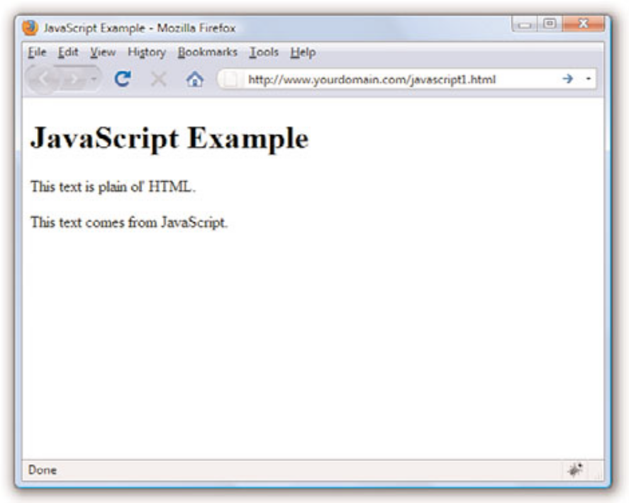
Using JavaScript to Print Some Text

Slide 7
Understanding the Document Object Model
Client-side interactivity using JavaScript typically takes the form of manipulating the DOM in some way.
The DOM is the invisible structure of all documents—not the HTML structure or the way in which you apply levels of formatting, but a sort of overall framework or container.
The overall container object is called the document. Any container within the document that has an ID is referenced by that ID.
For example, if you have a <div> with an ID called wrapper, then in the DOM that element is referenced by the following:
    document.wrapper

Slide 8
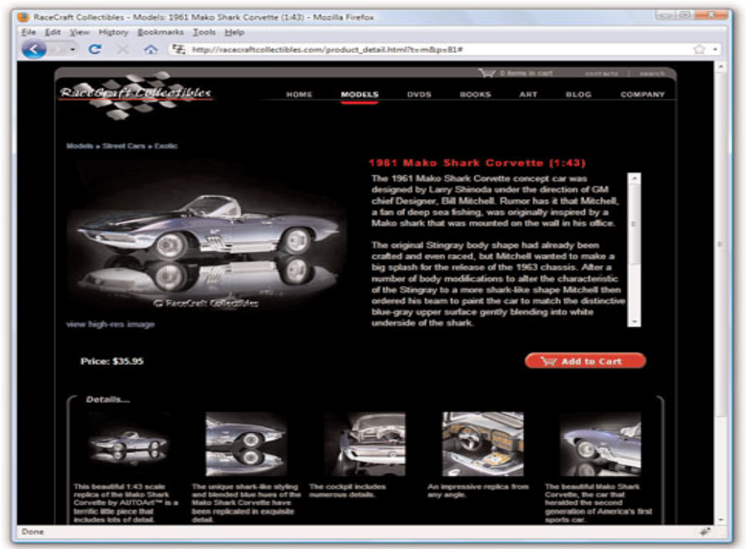
Changing Images Based on User Interaction

Slide 9
Changing Images Based on User Interaction
Figure shows a page from an online catalog for a collectibles company.
Each page in the catalog shows a large image, information about the item, and a set of smaller images at the bottom of the page.
In this type of catalog, close-up images of the details of each item are important to the potential buyer, but several large images on a page becomes unwieldy from both a display and bandwidth point of view.
The large image on the page is called using this <img/> tag:
  <img name=”product_img” src=”/path/to/image.jpg” alt=”photo” />

Slide 10
Changing Images Based on User Interaction
The following code snippet creates the fourth small image in the group of five images shown at the bottom of Figure.
The onmouseover event indicates that when the user rolls over this small image, the value of document.product_img.src—the large image slot—is filled with the path to a matching large image.
<a href=”#” onmouseover=”javascript:document.product_img.src =‘/path/to/large4.jpg’”><img src=”/path/to/small4.jpg” width=”104” height=”104” style=”padding: 4px; border: 0px” alt=”photo” /></a>

Slide 11
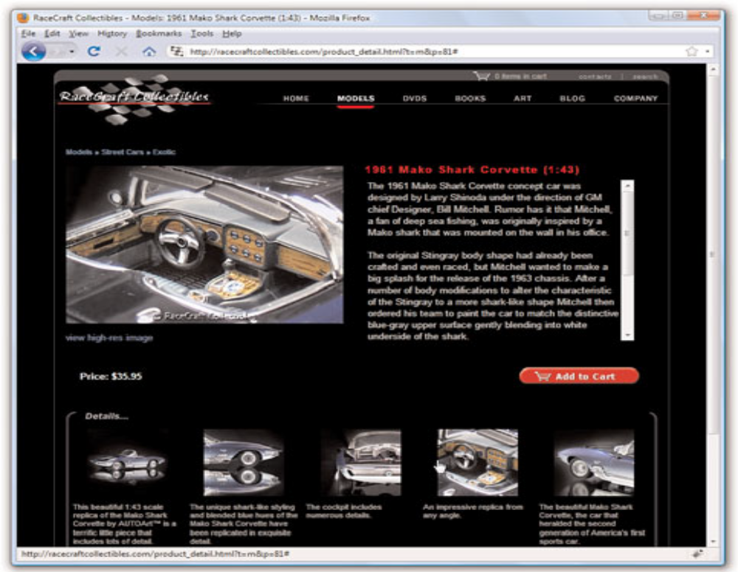
Changing Images Based on User Interaction

